Slide 1
GAIA Methodology
COMP 40040: Agent-Oriented Software
Lecturer: Rem Collier
Email: rem.collier@ucd.ie

Slide 2
Introduction
Many AOSE Methodologies have been proposed.
Knowledge Engineering Based Approaches:
MAS-CommonKADS
Agent Specific Approaches:
GAIA + Extensions
ROADMAP
SODA
Object-Oriented Based Approaches:
MESSAGE
Prometheus
MaSE
PASSI
Agent UML (Notation)
In this course we will look at GAIA

Slide 3
Recommended Reading
Michael Wooldridge, Nicholas R. Jennings, and David Kinny, “The Gaia methodology for agent-oriented analysis and design”, in Journal of Autonomous Agents Multi-Agent Systems Vol. 3, No. 3, pp 285–312, 2000
Franco Zambonelli, Nicholas R. Jennings, Michael Wooldridge, “Developing Multiagent Systems: The Gaia Methodology”, in ACM Transactions of Software Engineering and Methodology, Vol. 12, No. 3, pp 317-370, July 2003
Cernuzzi, L, Juan, T, Sterling, L, Zambonelli, F, “The Gaia Methodology: Basic Concepts and Extensions”, in Methodologies and Software Engineering for Agent Systems, Springer-Verlag, 2004.

Slide 4
Why Look at GAIA?
It’s different from other approaches:
It is founded upon a set of concepts that are well-suited for multi-agent systems.
It does not deal directly with particular modelling techniques
It is not tied to a single implementation.
However, GAIA does not:
Include support for the capturing and modelling of system requirements.
Offer any insights as to how the design may be implemented.

Slide 5
GAIA – Domain Characteristics
Agents are coarse-grained computational systems, each making use of significant computational resources.
GAIA-designed systems maximise some global quality measure, but may be sub-optimal from the point of view of the system components.
Gaia is not intended for systems that admit the possibility of true conflict.
GAIA makes no assumptions about the delivery platform.
Agents are heterogeneous, in that different agents may be implemented using different programming languages, architectures, and techniques.

Slide 6
GAIA – Domain Characteristics
GAIA supports the development of closed systems.
The organisation structure of the system is static, in that inter-agent relationships do not change at run-time.
The abilities of agents and the services they provide are static, in that they do not change at run-time.
The overall system contains a comparatively small number of different agent types (less than 100).

Slide 7
GAIA & Organisational Structures
To adequately model the target system, the analysis phase of GAIA adopts the view of the system as an organisation.
Their rationale for this is that the concept of an organisation fits with the concept of a multi-agent system:
A multi-agent system is comprised of a set of computational entities (agents) that play roles, and whose global system behaviour is realised through the interactions that occur between those entities.
Key Point: roles are a good level of abstraction for modelling the structure of an organisation.

Slide 8
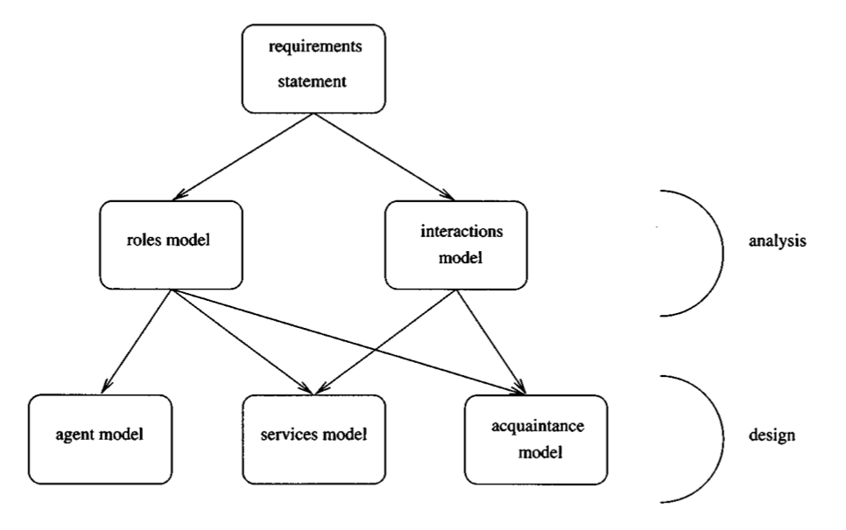
The GAIA Process
Gaia encourages a developer to think of building agent-based systems as a process of organisational design.

Slide 9
ANALYSIS PHASE

Slide 10
The Roles Model
Identifies the roles that agents will play in the final system.
E.g. President of the United States, Minister of Education, …
Roles are characterised by two types of attribute:
The permissions associated with the role.
What types of resource does it need to fulfil the role, and in what ways does it need to exploit them.
The responsibilities of the role.
What activities is the agent required to undertake when playing this role, and how should it use those activities to achieve the goals associated with the role.
Support for the construction of this model takes the form of a Role Schema template.

Slide 11
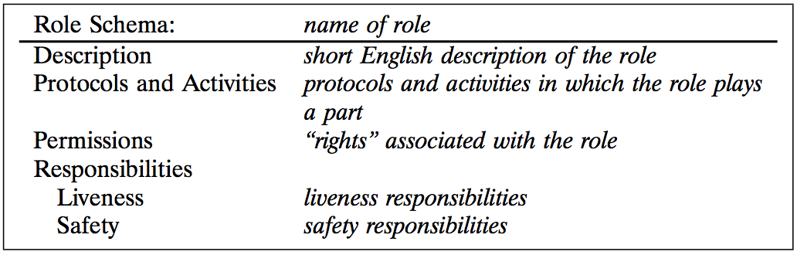
The Role Schema Template

Slide 12
Permissions
Permissions specify resource requirements for roles, represented as “the information or knowledge that an agent has”.
Some roles might generate information
Other may need to access / modify information
An access rights model is applied:
Read Access (read): the role must be able to access the specified information, but does not need to modify that information.
Write Access (change): the role must be able to modify the value of the specified information.
Create Access (generate): the role creates/generates the specified information.

Slide 13
Example: Lecture Attendance Monitoring Agent
Behaviour:
The agent is required to record attendance at the start of every lecture.
It does this by receiving a message from attending student agents, passing the students id number.
The LAM agent then reads the current time and adds an <id, time> tuple to the attendance records in the student registry.
Permissions:
The agent is able to read the current time
The agent is able to change the id of the student being checked
The agent is able to change the student registry to reflect the attendance of the student.

Slide 14
Responsibilities
Responsibilities define the functionality required by the role. They are divided into two categories:
Liveness Responsibilities. Those that, intuitively, state that “something good happens”.
Safety Responsibilities. Those that, intuitively, state that “nothing bad happens”.
That is, they specify invariants that must be maintained during the execution of the role.
For example, the invariant that the coffee stock is never empty can be represented by the following safety expression:
coffeeStock > 0
It is implicitly assumed that these responsibilities will apply across all states of the system execution.
If the role is infinitely long, then the invariant will always remain true.

Slide 15
Liveness Responsibilities
Liveness responsibilities are things that the agent must do while playing the role.
They are represented as a liveness expression – a regular expression that takes the form:
ROLENAME = expression
The atomic components of a liveness expression are:
Activities are fundamental actions that must be directly executable by the agent.
Protocols define interactions with other roles and are defined in the Interaction Model.
Liveness expressions to follow common patterns:
Guaranteed Response type achievement goals take the form “a request is always followed by a response”.
Infinite Repetition type achievement goals take the form “x will happen infinitely often”.

Slide 16
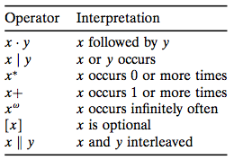
Liveness Expressions
LAM Agent:
LAM = ( Notify . ReadTime . Record )^{w}
Alternate solution:
LAM = ( Notify . Check . ReadTime .
CreateSlip . SubmitSlip )^{w}
For example:
COFFEEFILLER = (Fill . InformWorkers . CheckStock . AwaitEmpty)^{w}
Reuse and readability is also supported:
COFFEEFILLER = (All)^{w}
All = Fill . InformWorkers . CheckStock . AwaitEmpty

Slide 17
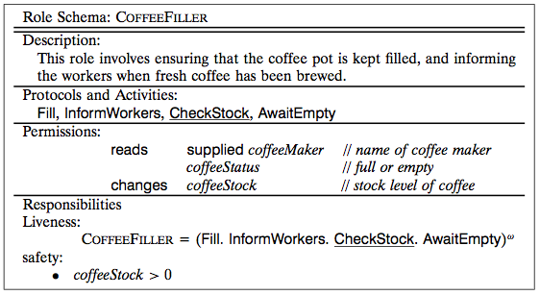
Example Schema

Slide 18
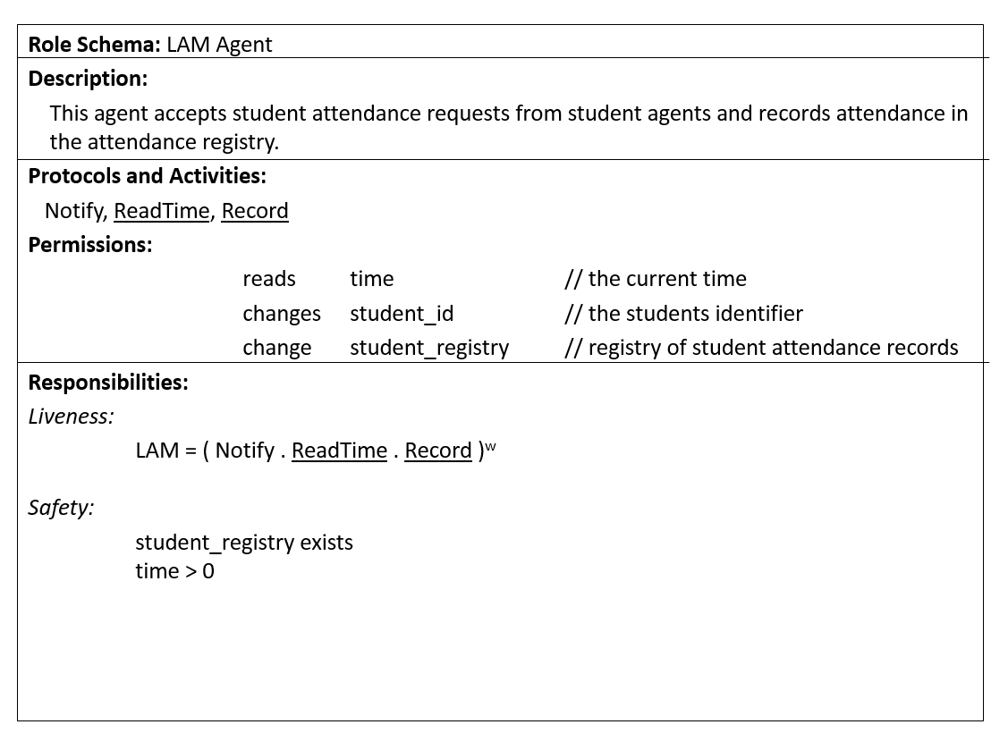
Example Schema

Slide 19
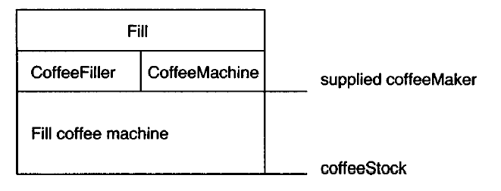
The Interactions Model
Consists of a set of protocol definitions that combine:
purpose: brief textual description of the nature of the protocol
initiator: the role(s) responsible for starting the interaction;
responder: the role(s) with which the initiator interacts;
inputs: information used by the role initiator while enacting the protocol;
outputs: information supplied by/to the protocol responder during the course of the interaction;
processing: brief textual description of any processing the protocol initiator performs during the course of the interaction.

Slide 20
The Analysis Process
Identify the roles in the system.
Deliverable: Unelaborated role model
For each role, identify and document the associated protocols.
Deliverable: Protocol Model
Using the protocol model as a basis, elaborate the roles model.
Deliverable: Elaborated role model
Iterate stages (1) - (3).
Refine the models

Slide 21
DESIGN PHASE

Slide 22
The Design Process
The goal of the design process is to transform the analysis models into a sufficiently low level of abstraction that traditional design techniques may be used to implement agents.
It involves the generation of three models that identify:
The agent types and agent instances that will make up the system (Agent Model).
The main services that are required to realise the model (Service Model).
The lines of communication between the different agents (Acquaintance Model).
Remember: GAIA has been designed for closed systems that have a static organisational structure!

Slide 23
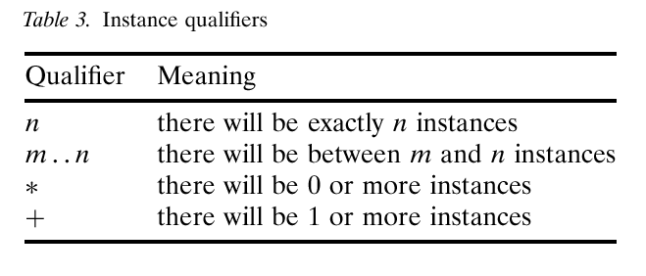
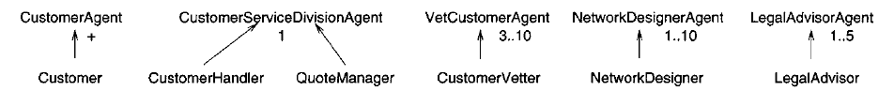
The Agent Model
The goal of this model is to identify what types of agent must exist.
Informally, an agent type is modelled as a set of roles that an instance of that type must play.
Types are represented using agent type trees.
These trees associate one or more agent roles with one or more agent types.
Instance qualifiers are used to specify how many instances of each type must exist.

Slide 24
The Services Model
In GAIA, a service is basically a function of an agent.
That is, the service model is used to refine the protocols, activities and responsibilities of the agent.
In general, there will be at least one service per protocol.
The service model specifies: inputs, outputs, pre-conditions, and post-conditions for each service (activity).
For example:
The CheckStock activity will take as input the stock level and some threshold value, and will simply compare the two.
The pre- and post-conditions will both state that the stock level is greater than zero.

Slide 25
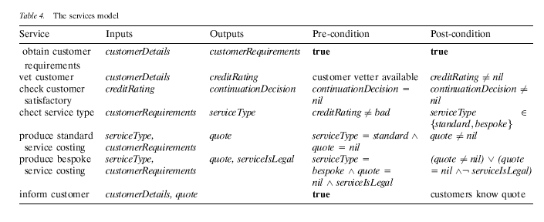
The Services Model

Slide 26
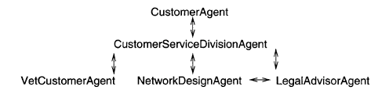
The Acquaintance Model
This third model specifies the lines of communication between the agent types.

Slide 27
The Design Process
Create an Agent Model:
Aggregate the roles into agent types and refine to form an agent type hierarchy
Document the instances of each agent type using instance annotations.
Develop a Service Model by examining the activities, protocols, and safety and liveness properties of each role.
Develop an Acquaintance Model from the Interaction Model and the Agent Model.

Slide 28
Summary
GAIA v.1 is designed for closed systems (<100 agent types):
Static community: all agents are identified at design time
Tight coupling: all agent relationships are identified at design time
Static functionality: all available services are identified at design time
However, some of the typical benefits of agent-based systems come from using them to build open systems:
Dynamic community: agents can be created / destroyed at runtime
Loose coupling: agents relationships
Dynamic functionality: new services can be added as required at run time.

